Slide 1
Project Presentation
On
Film Licensing Compliance

Slide 2

KISHKINDA UNIVERSITY
Established under Karnataka Act, No.20 of 2023Recognized by Government of Karnataka & UGC, New Delhi
Department of CSE
Internal Guide
Mr.T.Sukumar
Project Team Members:
1.Sharanya KUB23CSE062
2.Spoorthi.C KUB23CSE140
3.Nasiya Tasleem KUB23CSE091
4.Vasudha.U KUB23CSE156
5.Ummi Summaiya KUB23CSE150

Slide 3
INTRODUCTION:
1. In today's digital landscape, film licensing compliance is vital for [Company/Organization Name] to maintain its competitive edge and reputation.
2. As [Company/Organization Name] expands its media presence, ensuring film licensing compliance is essential for avoiding costly lawsuits and reputational damage.
3. This project will develop a comprehensive film licensing compliance program, aligning [Company/Organization Name] with industry best practices and regulatory requirements.

Slide 4
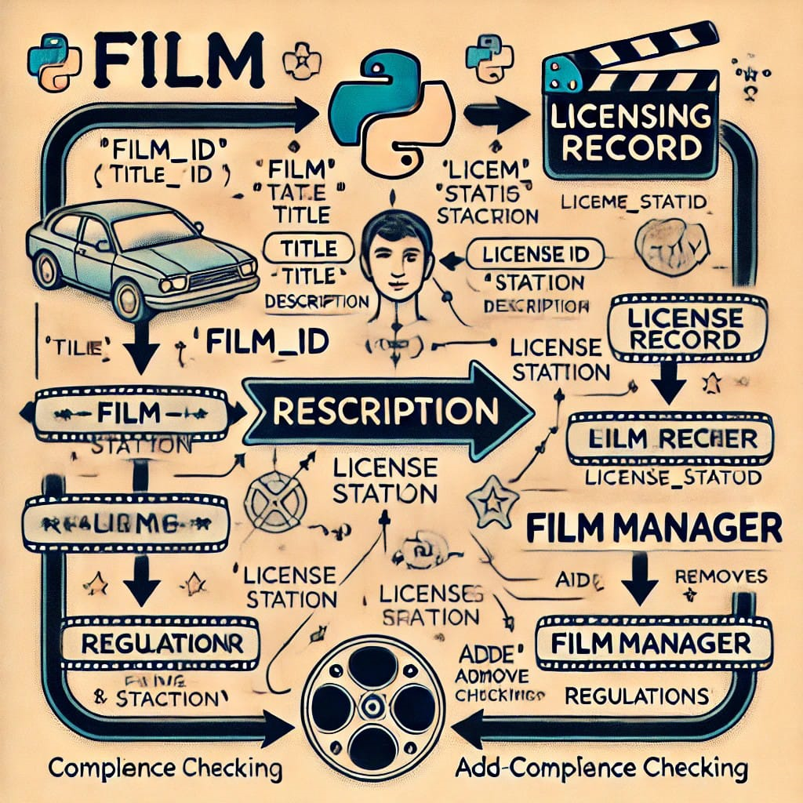
Objective :
Avoid copyright infringement and legal issues.
2. Obtain necessary licenses for content use.
3. Comply with territorial, platform, and usage restrictions.
4. Protect intellectual property rights.
5. Maintain reputation and credibility.
6. Streamline licensing processes and reduce costs.

Slide 5
Current Challenges:
Integrating disparate systems and formats.
Ensuring data accuracy, consistency, and security.
Developing scalable and flexible architecture.
Implementing robust encryption and access controls.
Managing complex licensing rules and regulations.

Slide 6
Existing System :
License Request Submission: Manual submission via email/phone.
License Review and Approval: Manual review by licensing team.
License Tracking: Manual tracking using spreadsheets.
4. Compliance Monitoring: Manual audits and checks.
5. Reporting: Manual reporting using spreadsheets

Slide 7
Proposed System :
License Request Submission: Online portal for submissions
License Review and Approval: Automated workflow with notifications
License Tracking: Real-time tracking and updates
Compliance Monitoring: Automated checks and alerts
Reporting: Automated reporting and analytics

Slide 8
Vision :
"Streamline film licensing compliance through a centralized, automated, and data-driven platform, ensuring transparency, efficiency, and accuracy in licensing management, minimizing risk and maximizing revenue for the entertainment industry."
Mission :
"Ensure seamless and secure film licensing processes, safeguarding intellectual property rights, and promoting transparency, accountability, and compliance with regulatory requirements, to foster a vibrant and sustainable entertainment industry."

Slide 9
Requirements Specification :
Functional Requirements
Non-Functional Requirements
Business Requirements
Technical Requirements

Slide 10
Software Requirements :
Python 3.12(64-bits)
Visual studio code
Hardware Requirements :
Processor : Intel i5
Ram : 64GB
Hard Disk : 500GB

Slide 11
Conclusion :
The Film Licensing Compliance Point of Contact project aims to streamline film licensing compliance, minimize risk, and maximize revenue for the entertainment industry. By implementing an automated, centralized, and data-driven platform, this project will:
Simplify complex licensing processes
Ensure adherence to copyright laws and regulations
3. Increase efficiency and reduce administrative burden
4. Provide real-time analytics and reporting

Slide 12
Future Enhancement :
Integration with emerging technologies (AI, blockchain, IoT)
Enhanced analytics and reporting capabilities
Mobile optimization for license request submission and tracking
Automated

Slide 13
References :
“Film Licensing : Law and practice” by Routledge
“Entertainment Law : Film and Television” by LexisNexis
“Intellectual Property Law for the Entertainment Industry” by West Academic Publishing
“Film Licensing Trends Report” by PwC

Slide 14
Thank you

